Slide 1
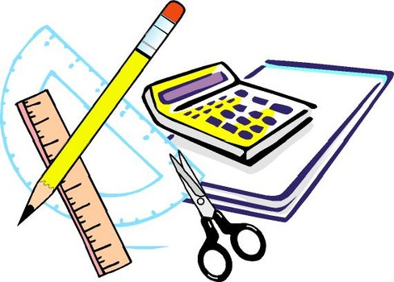
Learning Objective
I will recap probability.
Enter quietly, please be ready with the following on your desk:
Whiteboard
Whiteboard marker
Exercise Book
Pencil, pen, ruler and red pen
Diary
Calculator
Device – charged or borrowed from Library before maths

Slide 2
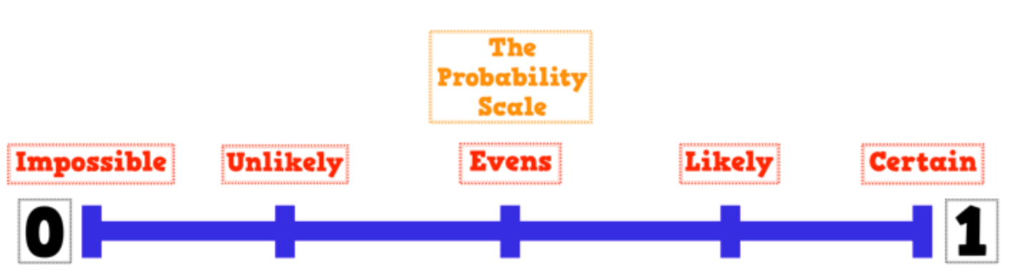
Activate Prior Knowledge
CFU
What are we going to learn?
You will spontaneously combust into flames.
The year after 2020 will be 2021.
You will go to the beach in December.
It will rain tomorrow.
If you flip a coin, it will land on a tails.
You will come to school tomorrow.
WCE will win the Grand Final.

Slide 3
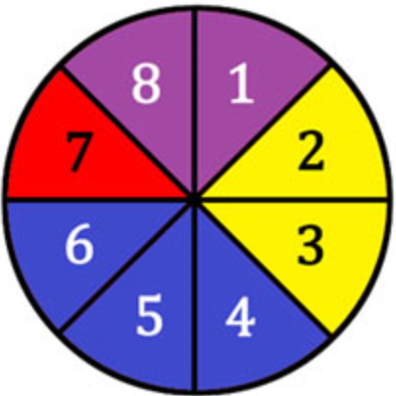
Learning Objective
CFU 1
What will we learn?
I will recap probability.
Success Criteria
I will be able to list sample spaces.
I will be able to calculate probabilities of single events.
I will be able to calculate probabilities of complementary events.

Slide 4
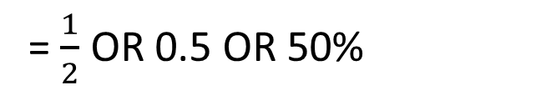
Concept Development
CFU 1
What is an everyday word for probability?
Probability describes how likely it is that something will happen.
To work out probability as a fraction, we do:
Number of successful outcomes
Number of outcomes in total
We write it like this:
The answer can be given as a fraction, decimal or percentage.
P(event)
For example:
P(landing on heads)
= $\frac{1}{2}$ OR 0.5 OR 50%

Slide 5
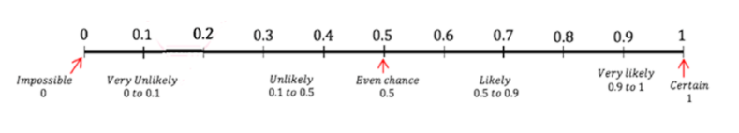
Daily Review
Probability can be expressed as decimals: eg 0.8
Probability is also expressed as fractions: eg $\frac{4}{5}$
Probability is also expressed as percentages: eg 80%
$$80\%$$
$$\frac{4}{5}$$

Slide 6
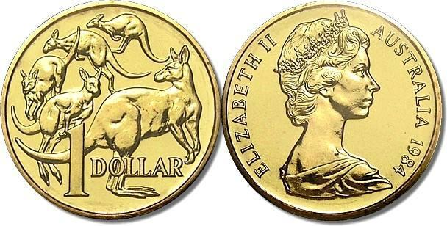

Daily Review
Flipping a coin: P(heads or tails) =
5$0\%$
$$\frac{1}{2}$$

Slide 7
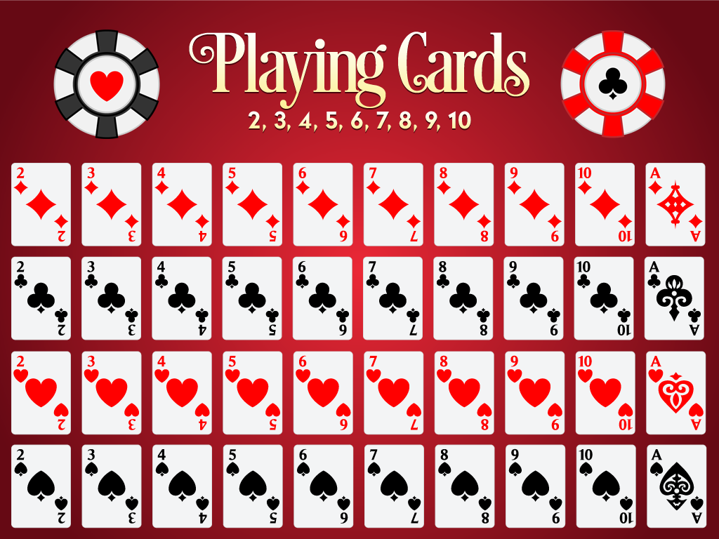
Daily Review
P(that you will pull a red card from a deck of cards) =
5$0\%$
$$\frac{1}{2}$$

Slide 8

Daily Review
P(that you will pull a card of hearts from a deck of cards) =
25$\%$
$$\frac{1}{4}$$

Slide 9

Daily Review
P(you will feel sleepy at some point) =
10$0\%$
$$1$$

Slide 10
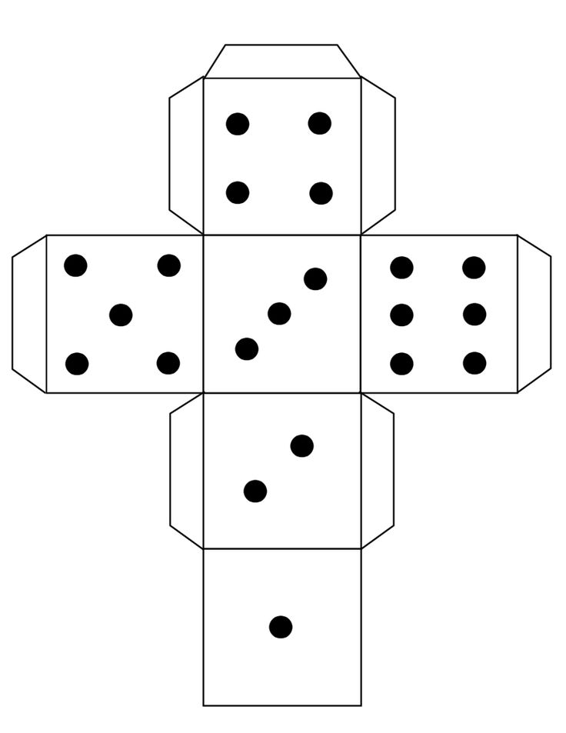
Daily Review
What is that probability that you will roll a 3 on a normal die?
The probability is $\frac{1}{6}$ as only 1 of the faces on a die has a 3 on it
What is the probability that you will roll an even number on a normal die?
The probability is $\frac{3}{6 }= \frac{1}{2}$
What is that probability that you will roll a 7 on a normal die?
The probability is 0 as a normal die does not have a 7 on a face

Slide 11








Skill Development
Number of successful outcomes Number of outcomes in total
$$\frac{3}{5}$$
P(red)
P(blue)
P(H)
P(M)
P(vowel)
P(consonant)
P(letter)
$$\frac{2}{5}$$
M A
T H E
M A T
I C S
$$\frac{1}{11}$$
$$\frac{2}{11}$$
$$\frac{4}{11}$$
$$\frac{7}{11}$$
$$\frac{11}{11}=1$$

Slide 12
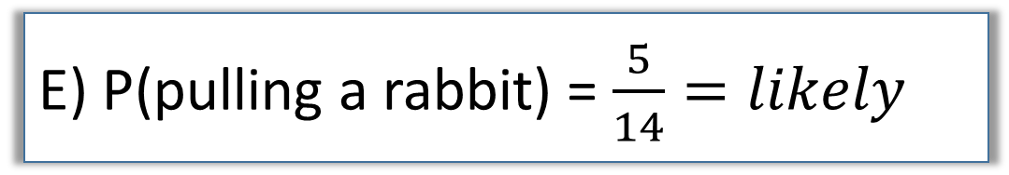
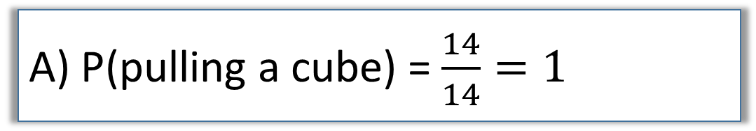
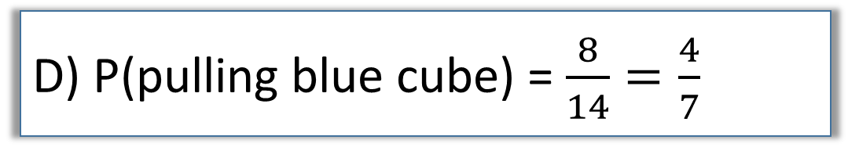
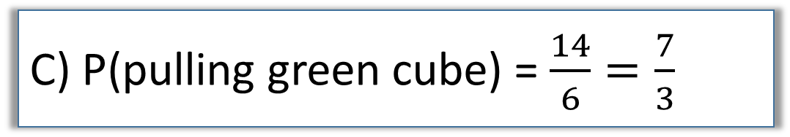
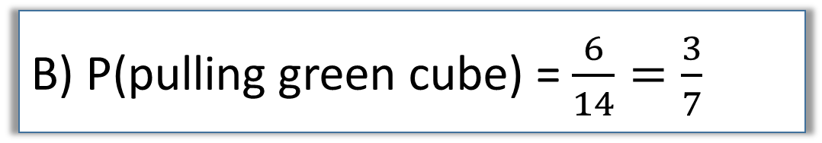
Hinge-point Question
Which of the options below are correct? (there could be more than one)
A) P(pulling a cube) = $\frac{14}{14}=1$
B) P(pulling green cube) = $\frac{6}{14}=\frac{3}{7}$
C) P(pulling green cube) = $\frac{14}{6}=\frac{7}{3}$
D) P(pulling blue cube) = $\frac{8}{14}=\frac{4}{7}$
E) P(pulling a rabbit) = $\frac{5}{14}=likely$

Slide 13
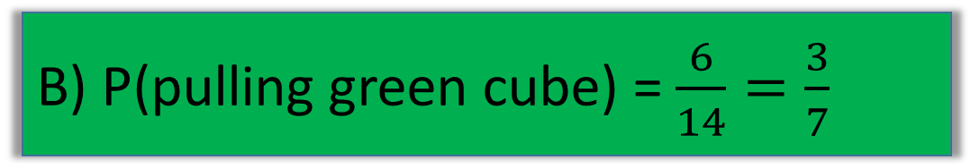


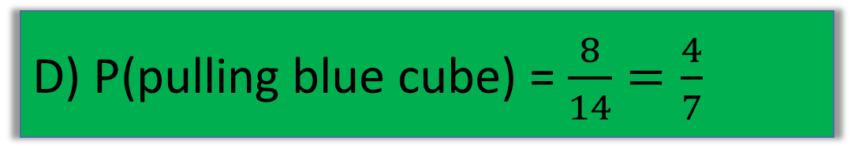
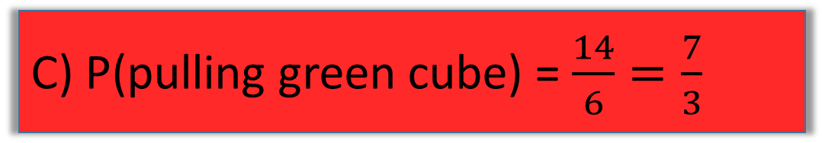
Hinge-point Question
Which of the options below are correct? (there could be more than one)
A) P(pulling a cube) = $\frac{14}{14}=1$
B) P(pulling green cube) = $\frac{6}{14}=\frac{3}{7}$
C) P(pulling green cube) = $\frac{14}{6}=\frac{7}{3}$
D) P(pulling blue cube) = $\frac{8}{14}=\frac{4}{7}$
E) P(pulling a rabbit) = $\frac{5}{14}=likely$

Slide 14

Daily Review
A class has 26 students, with 10 studying Chinese and the rest studying Japanese.
How many students study Japanese?
What is the probability that a student studies Japanese?
$26 – 10 = 16$, so 16 students studied Japanese
$$=\frac{8}{13}$$
P(a student studies Japanese) $= \frac{16}{26}$
P(a student studies Chinese) $= \frac{10}{26}= \frac{5}{13} (complement probability)$
P(a student is a master at origami) $= \frac{0}{26} (impossible)$

Slide 15
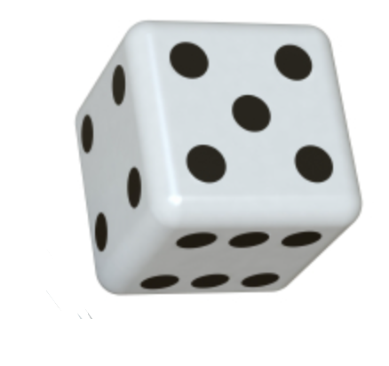

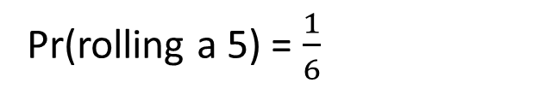
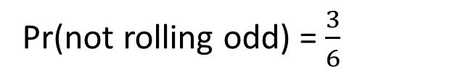
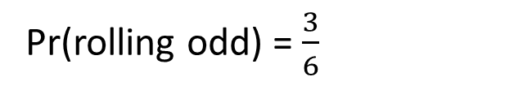


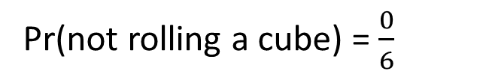
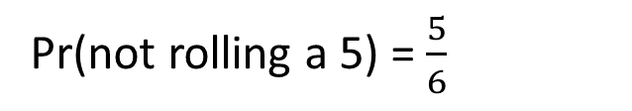
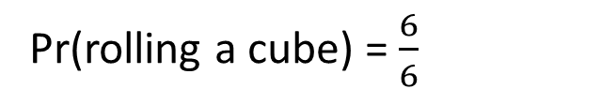
Guided Practice
Complement probability – the probability of something not happening.
P(event happening) + P(event not happening) = 1
Pr(rolling a 5) = $\frac{1}{6}$
Pr(not rolling a 5) = $\frac{5}{6}$
$$\frac{1}{6}+\frac{5}{6}=1$$
Pr(rolling odd) = $\frac{3}{6}$
Pr(not rolling odd) = $\frac{3}{6}$
$$\frac{3}{6}+\frac{3}{6}=1$$
Pr(rolling a cube) = $\frac{6}{6}$
Pr(not rolling a cube) = $\frac{0}{6}$
$$\frac{1}{6}+\frac{5}{6}=1$$

Slide 16

Guided Practice
Everyone in the class (28) receive a box. 23 of the boxes are filled with lollies and 5 of them are empty.
what is the P(you will get an empty box)?
What is the P(you will get lollies)?
Of the 30 students in class, 19 of them have an android, while the others have iPhones.
what is the P(you have an android)?
What is the P(you have an iPhone)?
a) $P\left(\text{receive} lollies\right)=\frac{23}{28}$
a) $P\left(\text{you} \text{have} \text{an} \text{android}\right)=\frac{19}{30}$
b$) P\left(\text{receive} \text{a}n empty box\right)=\frac{5}{28}$
b$) P\left(\text{you} \text{have} \text{an} \text{iphone}\right)=\frac{11}{28}$
example problem pairs

Slide 17
Guided Practice
Jenny has 50 pens in her pencil case. 44 are sparkly and 6 are red.
What is the estimated probability she will reach in and pull out a sparkly pen?
What is the estimated P(Jenny pulls out a red pen)?
Brian asked 50 friends if he could have $5.00 and 19 of them agreed to give him the money.
What is the estimated probability if he asks another friend for money they will give it to him?
What is the estimated P(Brian does not get another $5)?
a) $P\left(\text{Jenny} \text{pulls} \text{sparkly} \text{pen} \right)=\frac{44}{50}=\frac{88}{100}=$ 0.88
a) $P\left(Brian gets another \$5\right)=\frac{19}{50}=\frac{38}{100}=$ 0.38
b$)P\left(\text{Jenny} \text{pulls} red pen\right)=\frac{6}{50}=\frac{12}{100}\text{=} \text{0.}\text{12}$
b$)P\left(Brian does not get another \$5\right)=\frac{31}{50}=\frac{62}{100}\text{=} \text{0.}\text{62}$
example problem pairs

Slide 18
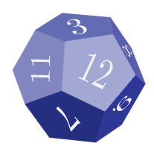
Guided Practice
Sample space – a list of all possible outcomes.
Eg. Rolling a dice. The sample space is 1, 2, 3, 4, 5, 6.
Write down the sample space when rolling this 12 sided dice.
The sample space is 1, 2, 3, 4, 5, 6, 7, 8, 9, 10, 11, 12.

Slide 19
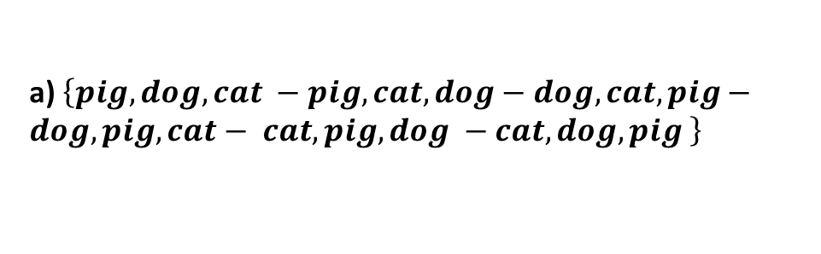
Guided Practice
a) List the sample space when a coin is toss twice
b) List the sample space when a coin is toss three times
a) list the sample space for the order that a pig, dog, and a cat walk through the doorway.
a) $\left\{pig, dog, cat −pig, cat, dog−dog, cat, pig−dog,pig, cat− cat, pig, dog −cat, dog, pig \right\}$
a) $\{HH, HT, TH, TT\}$
b$) \{HHH, HHT, HTH, THH, HTT, TTH, THT, TTT\}$
It will be much easier to use tree diagrams to get all the combinations!
example problem pairs

Slide 20



Guided Practice
Robin loves to play football with his mates after school, but he also loves to play his guitar. He can’t decide what to do, so he tosses a coin for three days.
Heads mean he will play football that day and tails means he will play his guitar. Find the probability that he:
Plays football 3 days in a row
Plays guitar at least 2 days in a row
Doesn’t play football 3 days in a row.
H = Football, T = Guitar
Step 1: List all possible outcomes
$$\{HHH, HHT, HTH,HTT,THH,THT,TTH, TTT\}$$
$$=\frac{1}{8}$$
a) $P\left(Football 3 days in a row\right)=P(HHH)$
$$=\frac{3}{8}$$
b) $P\left(Guitar at least 2 days in a row\right)=P(HTT, TTH, TTT)$
$$=\frac{7}{8}$$
c) $P\left(Doesn^{′}t play footbal 3 days in a row\right)=1−P(HHH)$

Slide 21
Concept Development
Duncan spins a spinner with the numbers 1, 2 and 3 on it and rolls a die.
What is the probability of getting a 2 with the spinner and a 5 with the die?
Step 1: draw the 3 lines for the possible spinner outcome
(ensure they are lined up perfectly)
Step 2: draw the 6 lines for the possible die outcome
(ensure they are lined up perfectly)
Step 3: List the sample space
Step 4: Determine the outcomes where the spinner is 2 and the die is 5
Step 5: P(getting a 2 and 5) $=\frac{1}{18}$

Slide 22

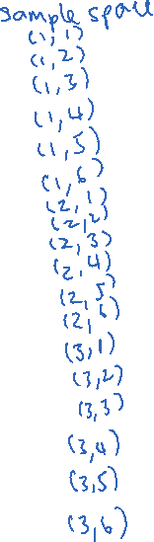
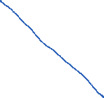








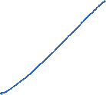


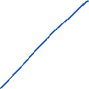




Concept Development
Duncan spins a spinner with the numbers 1, 2 and 3 on it and rolls a die.
What is the probability of the following
P(double number) =
P(numbers with 3 in them) =
P(numbers) =
$$\frac{3}{18}$$
$$\frac{8}{18}$$
$$\frac{18}{18}$$

Slide 23
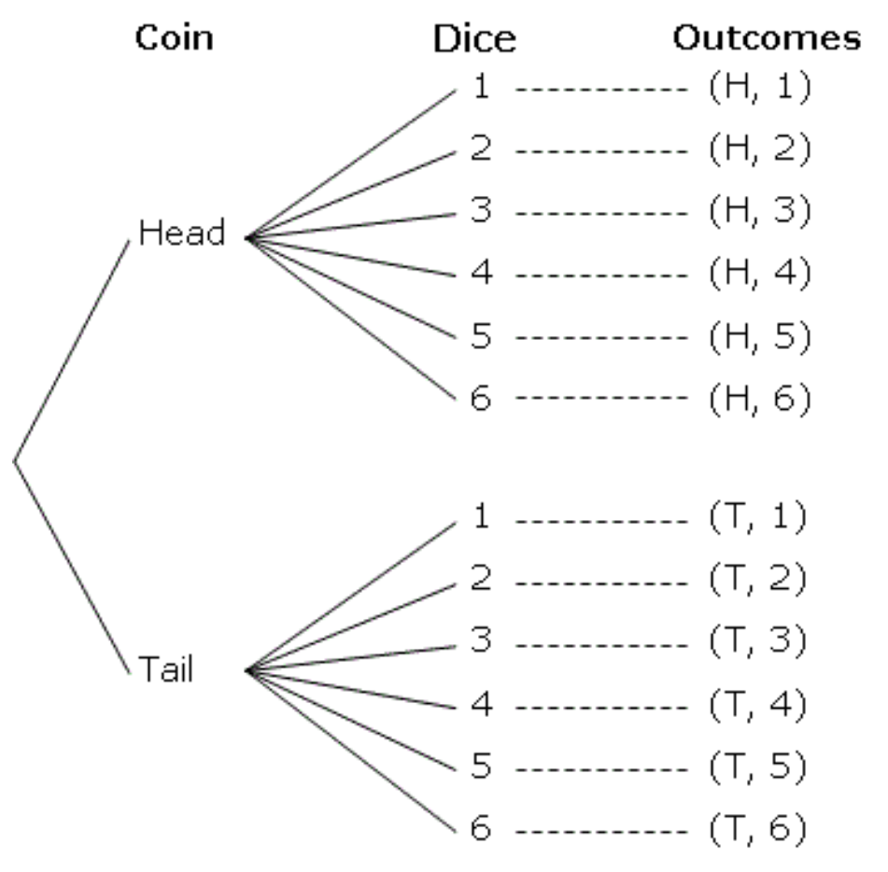
Concept Development
A coin and a dice are randomly thrown. Represent all possible outcomes using a tree diagram. List the sample space. Find the probability of getting tails and an even number.
Step 1: draw the 2 lines for the possible coin outcome
(ensure they are lined up perfectly)
Step 2: draw the 6 lines for the possible die outcome
(ensure they are lined up perfectly)
Step 3: List the sample space
Step 4: Determine the outcomes where the coin is tails and the die is even
Step 5: P(tails on coin and even on die) $=\frac{3}{12}=\frac{1}{4}$

Slide 24
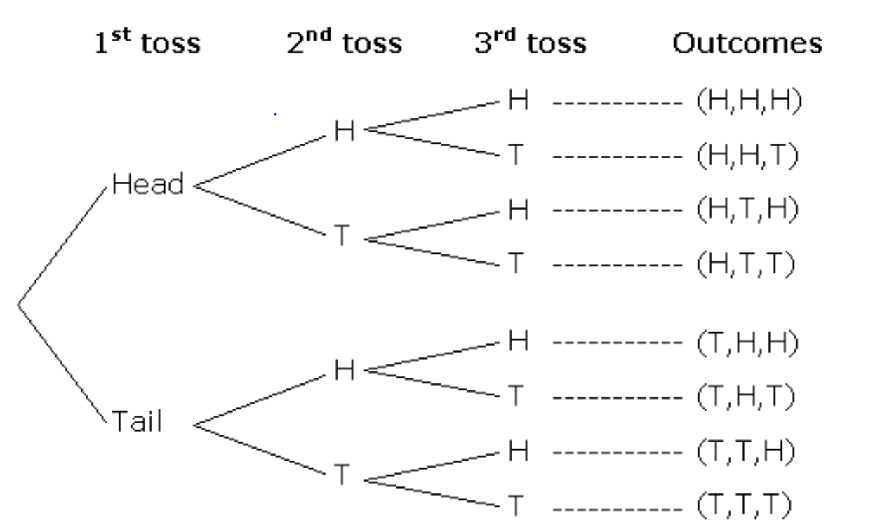
Concept Development
Claire tossed a coin three times. Find the probability of getting 3 tails.
Step 1: draw the 2 lines for the possible coin outcome
(ensure they are lined up perfectly)
Step 2: draw the 4 lines for the possible coin outcome
(ensure they are lined up perfectly)
Step 3: List all the sample space
Step 4: determine the outcomes which have 3 tails
Step 5: P(3 tails)$=\frac{1}{8}$ is 1/8

Slide 25
Concept Development
For breakfast, I have the choice of either weetbix or cornflakes to eat, and juice, milk or coffee to drink. Draw a tree diagram and determine the probability of having weetbix and coffee for breakfast.
Two step probability events can also be represented using Two-Way tables

Slide 26


















Concept Development
Duncan spins a spinner with the numbers 1, 2 and 3 on it and rolls a die. What is the probability of getting a 3 with the spinner and an even number with the die – show the data using a table.
 |  | Die
 |  | 1 | 2 | 3 | 4 | 5 | 6
Spinner | 1
 | 2
 | 3
$$(1,1)$$
$$(1,2)$$
$$(1,3)$$
$$(1,4)$$
$$(1,5)$$
$$(1,6)$$
$$(2,1)$$
$$(2,2)$$
$$(2,3)$$
$$(2,4)$$
$$(2,5)$$
$$(2,6)$$
$$(3,1)$$
$$(3,2)$$
$$(3,3)$$
$$(3,4)$$
$$(3,5)$$
$$(3,6)$$
Step 1: label the horizontal with die & possible values
Step 2: label the vertical with spinner and possible values
Step 3: Determine outcomes where the spinner is 3 and the die is even
Step 4: P(getting a 3 and even)$=\frac{3}{18}=\frac{1}{6}$

Slide 27




































Concept Development
Two dice are rolled. One die is numbered 1, 1, 2, 2, 3, 3. The other is 2, 4, 6, 8, 10, 12. Both dice are rolled and the numbers are added.
Draw a table to show the sample space.
Determine P(sum is even)
Determine P(sum > 10)
 |  | 2nd Die
 |  | 1 | 1 | 2 | 2 | 3 | 3
1st Die | 2
 | 4
 | 6
 | 8
 | 10
 | 12
$$3$$
$$(3)$$
$$(4)$$
$$(4)$$
$$(5)$$
$$(5)$$
$$(5)$$
$$(5)$$
$$(6)$$
$$(6)$$
$$(7)$$
$$(7)$$
$$(7)$$
$$(7)$$
$$(8)$$
$$(8)$$
$$(9)$$
$$(9)$$
$$(9)$$
$$(9)$$
$$(10)$$
$$(10)$$
$$(11)$$
$$(11)$$
$$(11)$$
$$(11)$$
$$(12)$$
$$(12)$$
$$(13)$$
$$(13)$$
$$(13)$$
$$(13)$$
$$(14)$$
$$(14)$$
$$(15)$$
$$(15)$$
a) P(sum is even)=$\frac{12}{36}=\frac{1}{3}$
b) P(sum> 10)=$\frac{12}{36}=\frac{1}{3}$

Slide 28
Independent Practice
Independent Practice
Pearson Ex 10.1 Q 1 to 17

